Slide 1
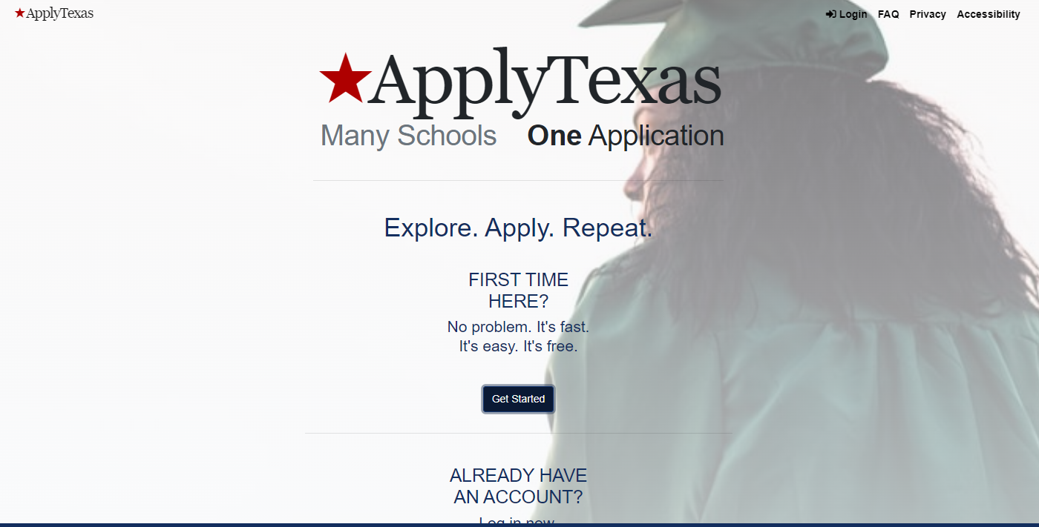
https://goapplytexas.org/

Slide 2
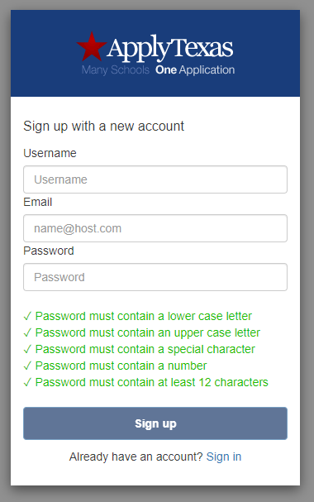
Create username and password. Use email address you check most often.
Password Requirements
12 or more characters
Lower case letter
Upper case letter
Special character
Number

Slide 3
Verify your email from within your email account
& Continue

Slide 4
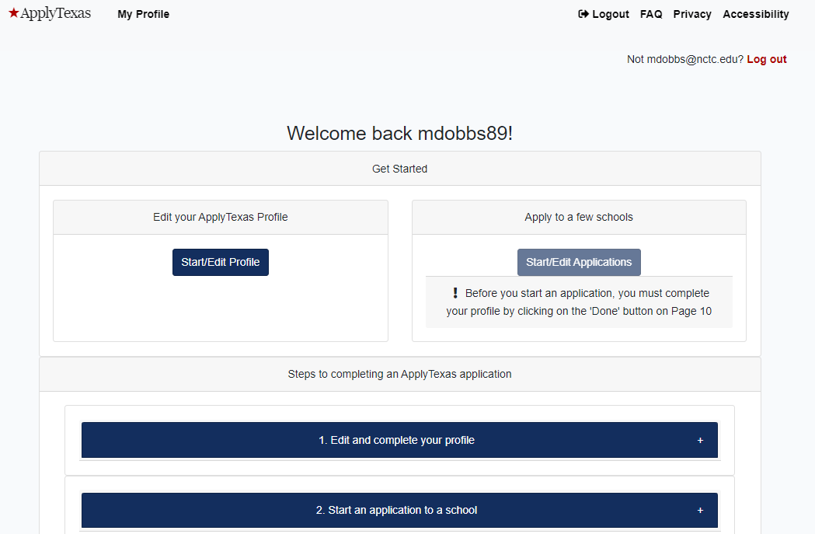
Start/Edit Profile

Slide 5
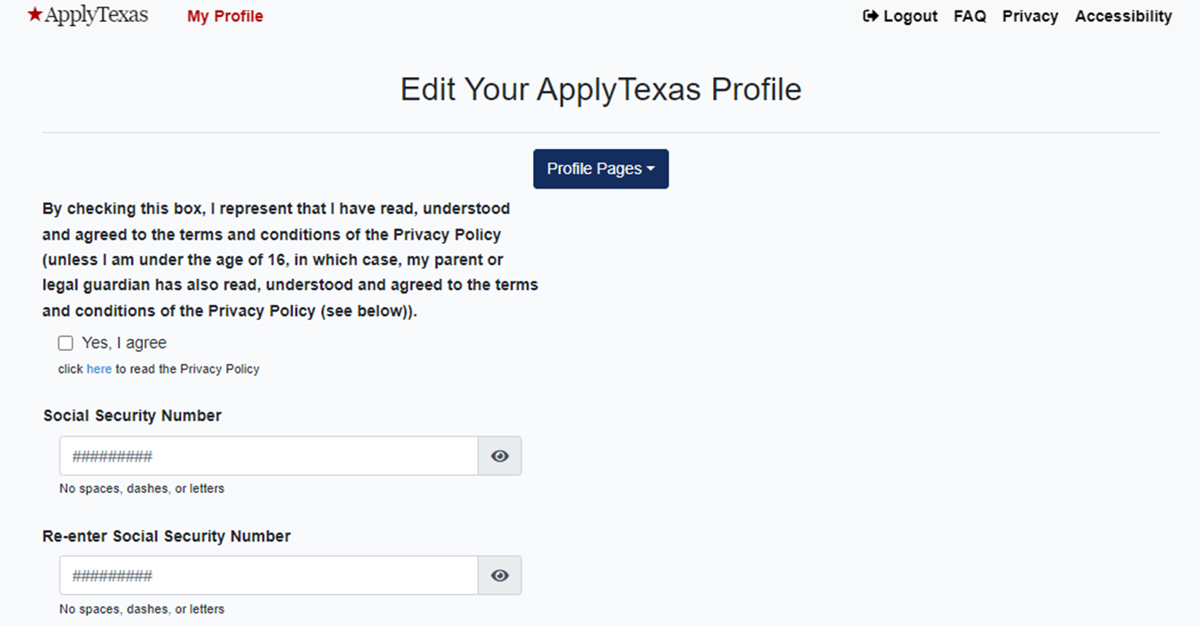
Check
Yes, I agree
to Privacy Policy

Slide 6
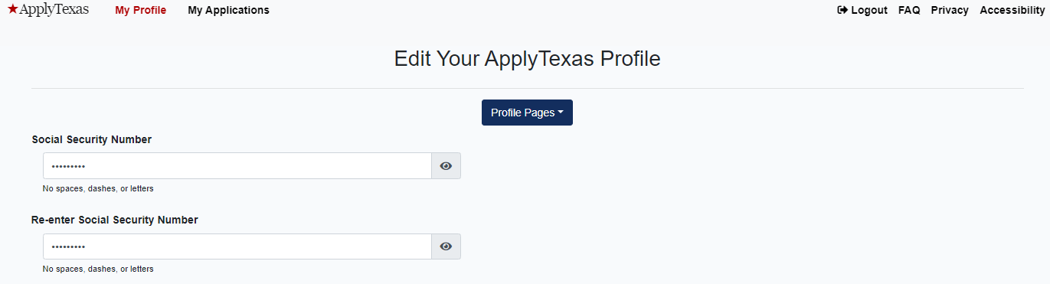
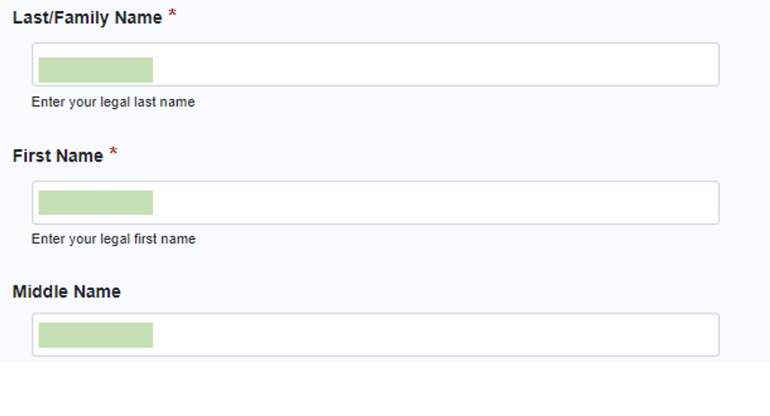
Enter your Social Security number if you have one

Slide 7
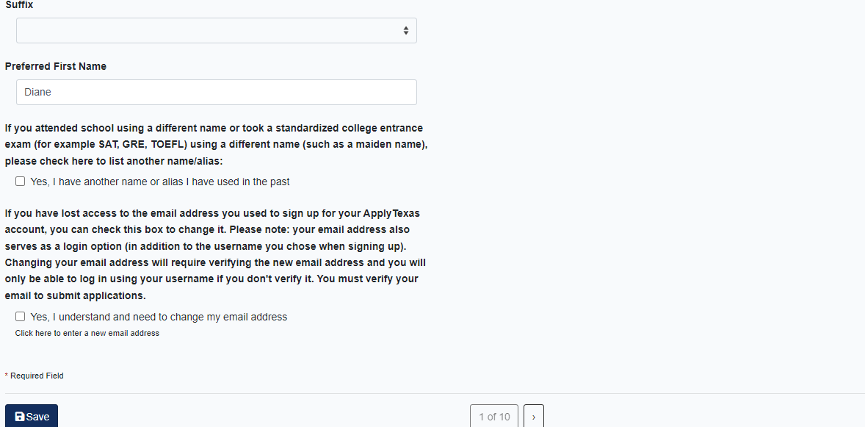
Will typically
NOT check these
Proceed

Slide 8
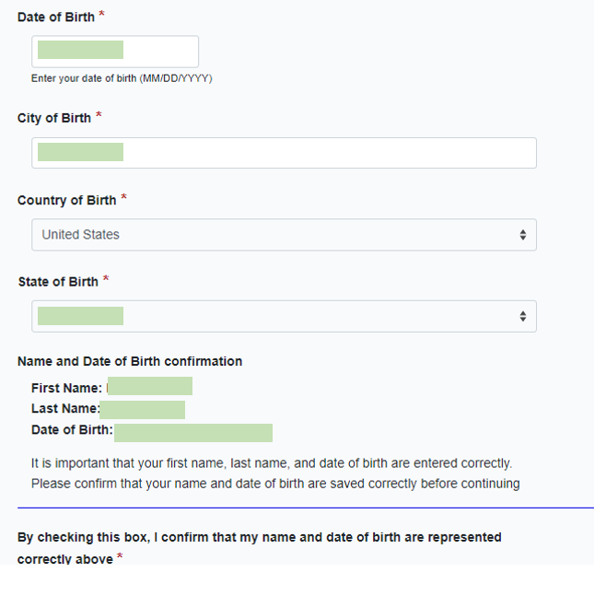
Type in your birthday
Review for accuracy

Slide 9
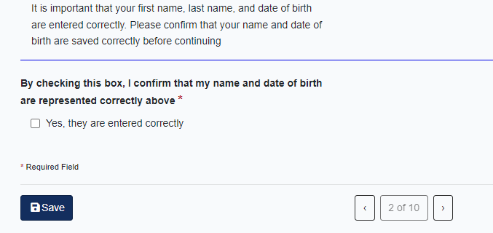
Check box if correct
Proceed

Slide 10
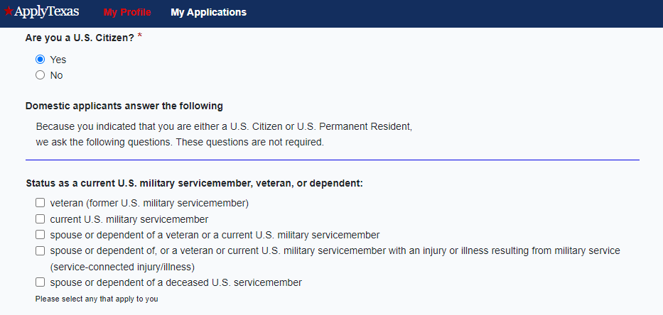
Typically Yes. Check No if you are not a US citizen.
Leave blank unless your parent has served in the military

Slide 11
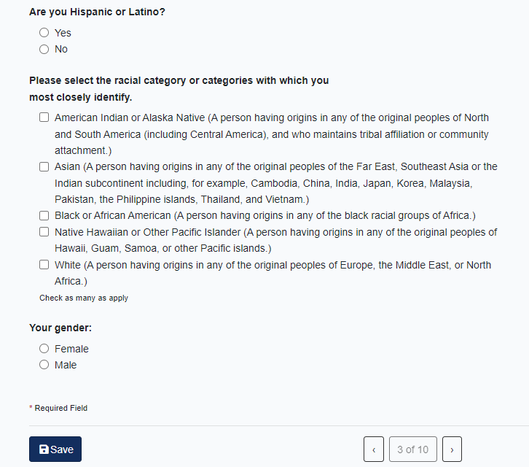
Select all that apply or leave blank
Proceed

Slide 12
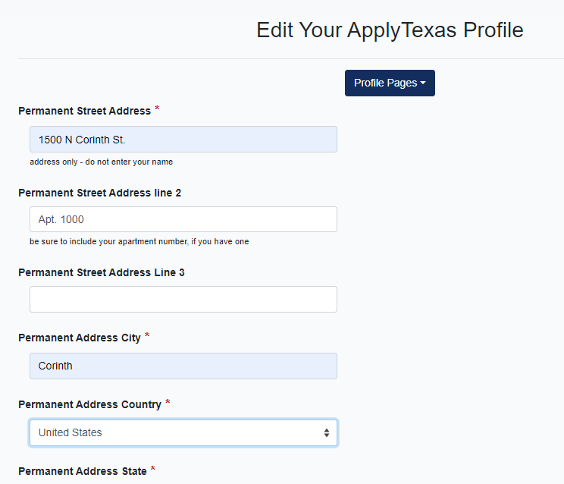
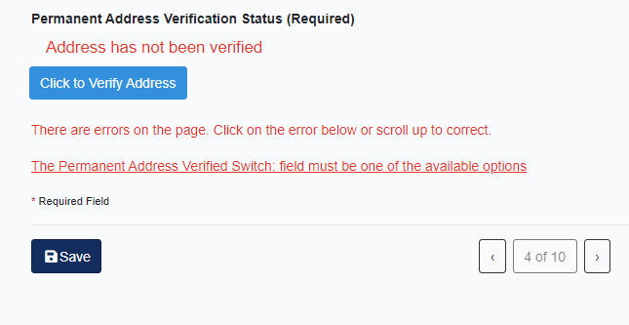

Enter your home address
Apartment, building, or lot number if you have one
Click
Proceed

Slide 13
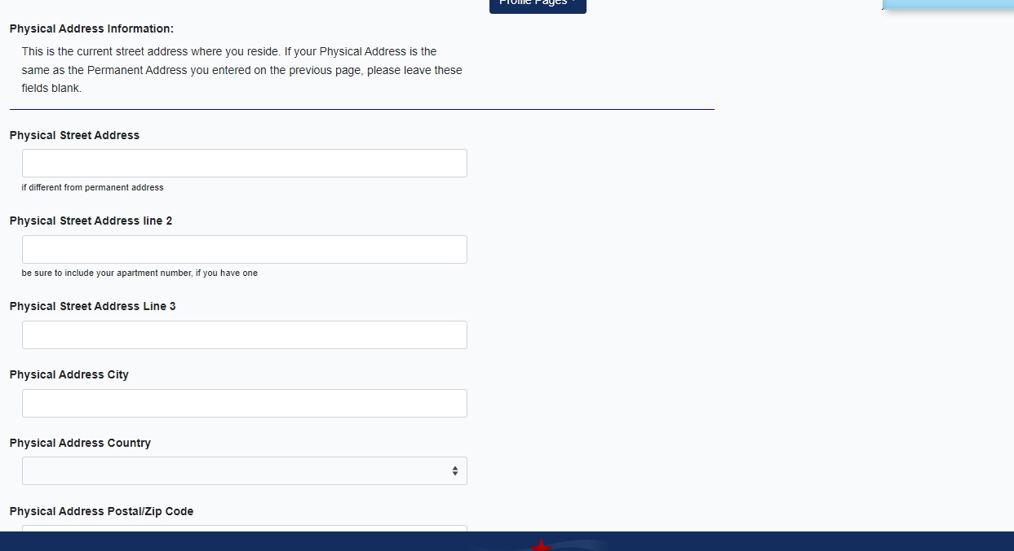
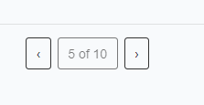
Physical Address
Leave Blank UNLESS
Your mailing address is different than physical address
Proceed

Slide 14
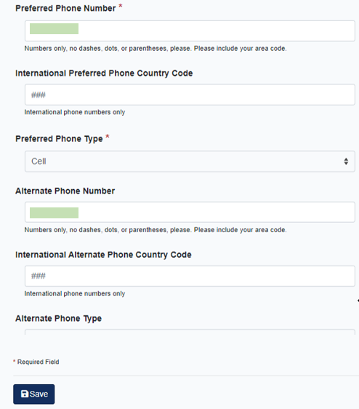
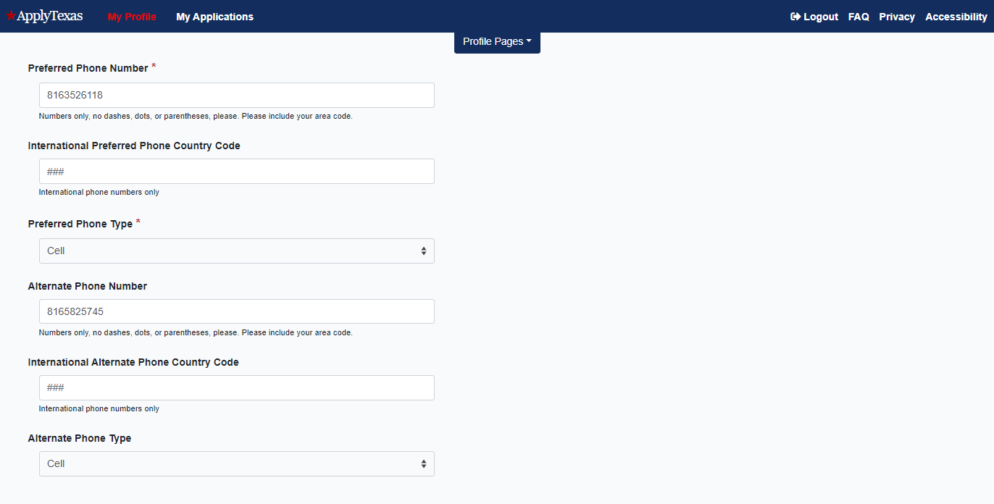
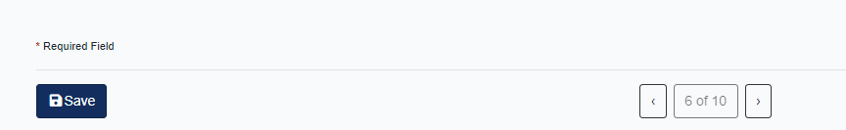
Enter YOUR cell number if you have one.
Cell numbers enable NCTC to send you reminders via text message
Leave Blank
Parent/Guardian Phone Number
Proceed

Slide 15
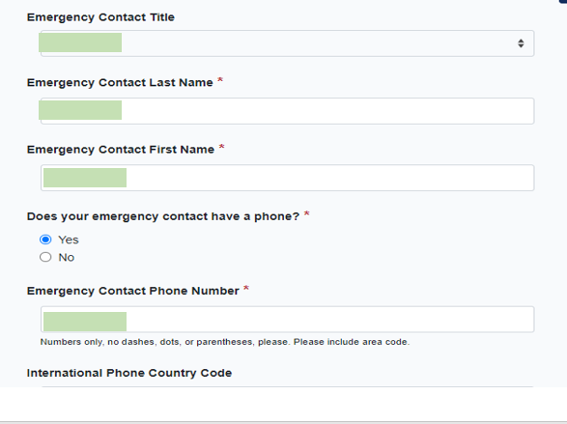
Enter Parent/Guardian Information

Slide 16
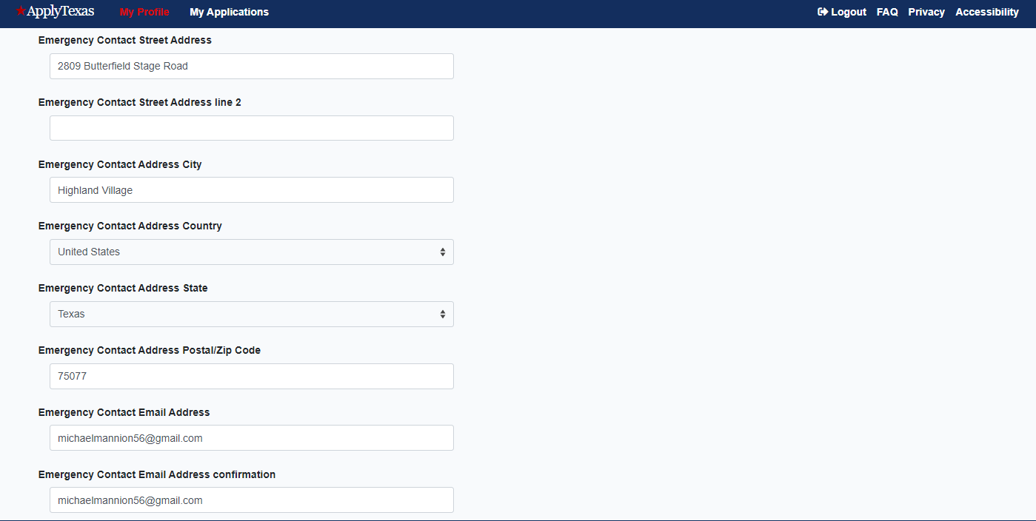

Important to put Parent’s Information and EMAIL
Proceed

Slide 17
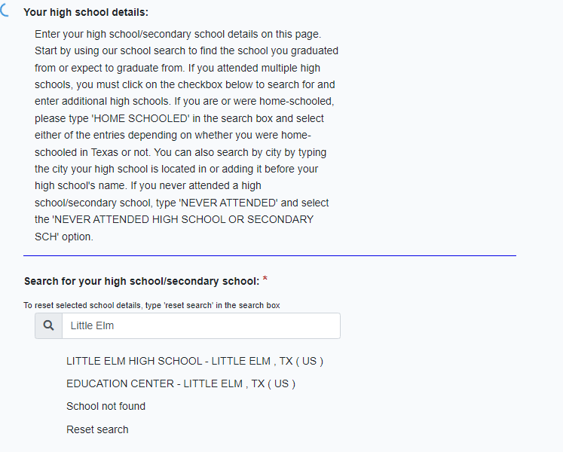
Begin to type school name
When you see your school appear in list, click on it to select

Slide 18
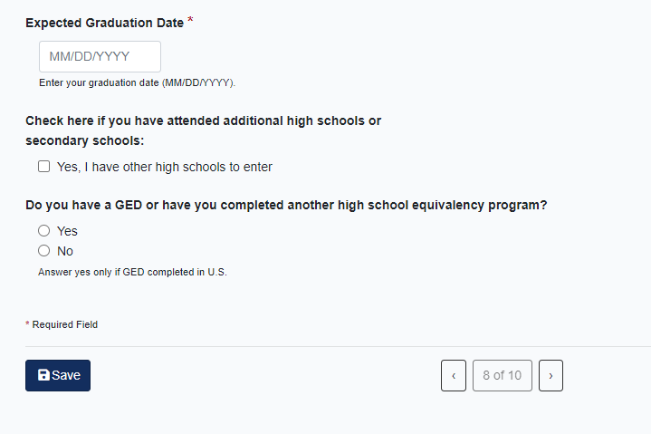
Estimate graduation date if unknown
No
Proceed

Slide 19
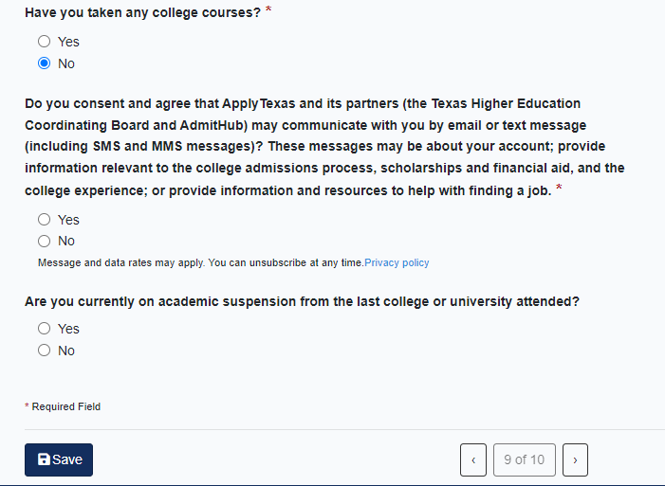
No. Answer Yes only if you’ve taken dual credit before.
Yes
No
Proceed

Slide 20
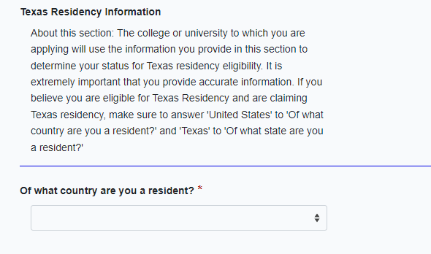
Residency
Answer Correctly.
Typically United States

Slide 21
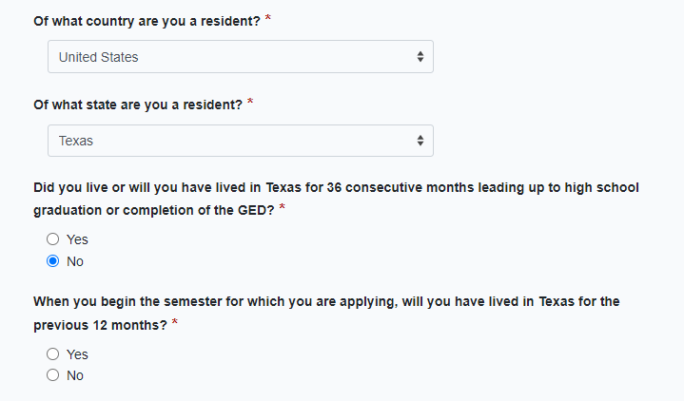
MUST ANSWER NO
ANSWER CORRECTLY. ASK IF YOU ARE NOT SURE

Slide 22
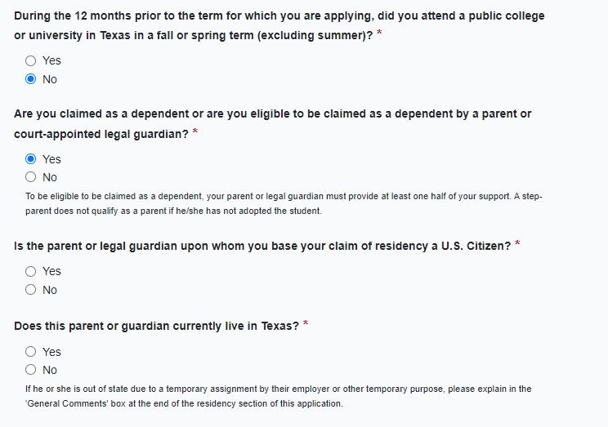
No. Yes only if prior dual credit in Texas
Yes
Answer correctly. Ask if you are not sure.
If no, permanent residency questions appear.
YES Very important to answer this yes! If you have a question, consult with a Dual Credit Success Coach

Slide 23
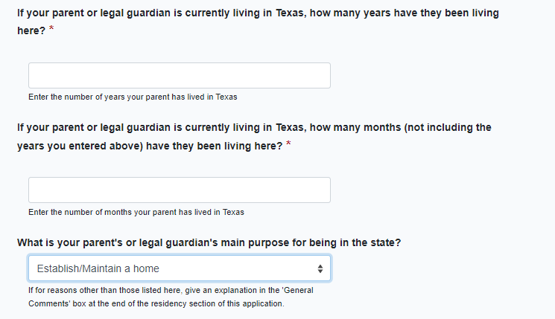
You can estimate if you don’t know.
Establish/Maintain a home

Slide 24
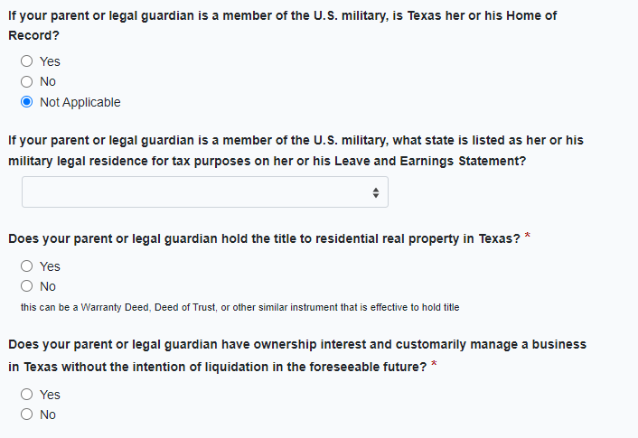
If yes, prompted to enter date acquired. Put YES if parents are buying a house.
If yes, prompted to enter date acquired.

Slide 25
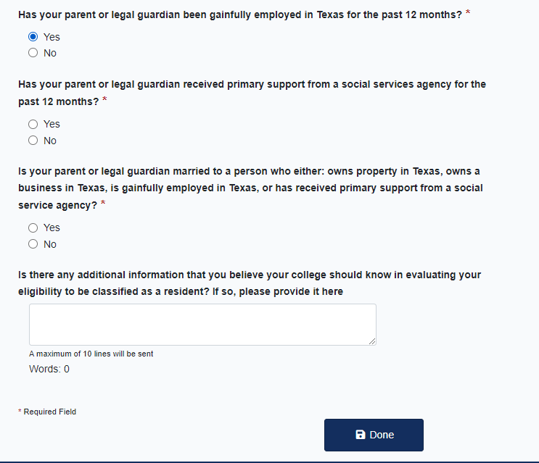
Typically Yes. ASK US IF YOU ARE NOT SURE!!!
Frequent scenarios: Both parents work? Then, Yes.
Both parents own your house? Then, Yes.
You can leave this blank

Slide 26
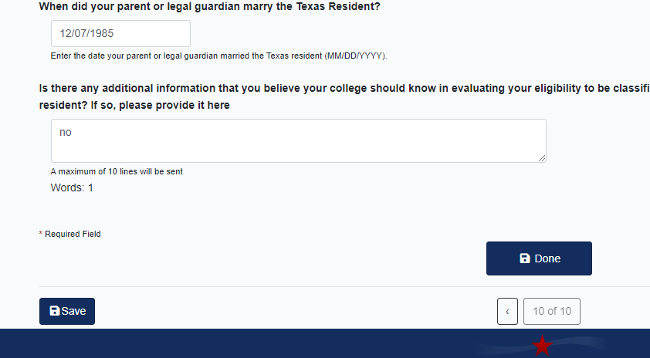
If you answered that your parent/guardian is married to a Texas resident…
Estimate if you don’t know.
Done with profile

Slide 27
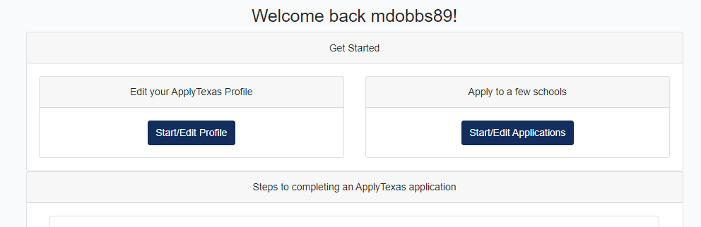
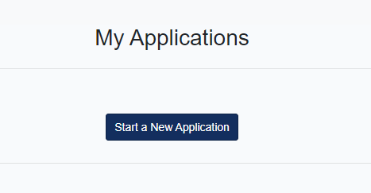
Start/Edit Applications
Start a New Application

Slide 28
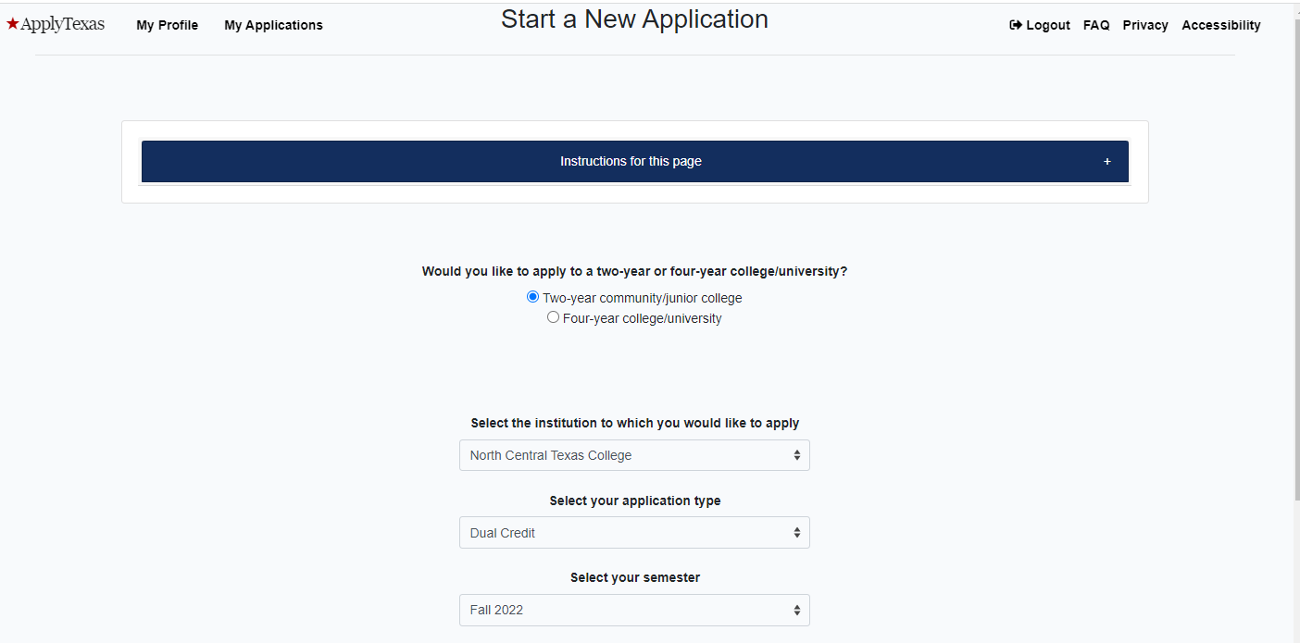
Two-Year
Open dropdown menu and type ‘North’ Select North Central Texas College.
Dual Credit
Semester you will start classes with NCTC

Slide 29


Slide 30
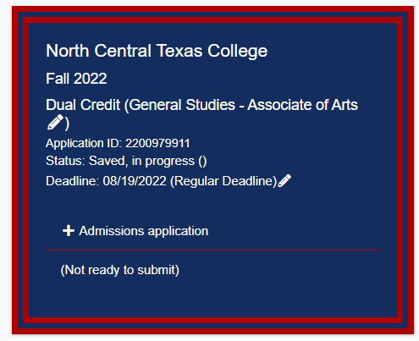
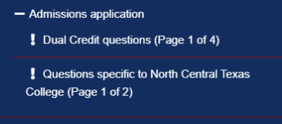
Scroll down until you see this:
Click Dual Credit Questions
Click to expand menu

Slide 31
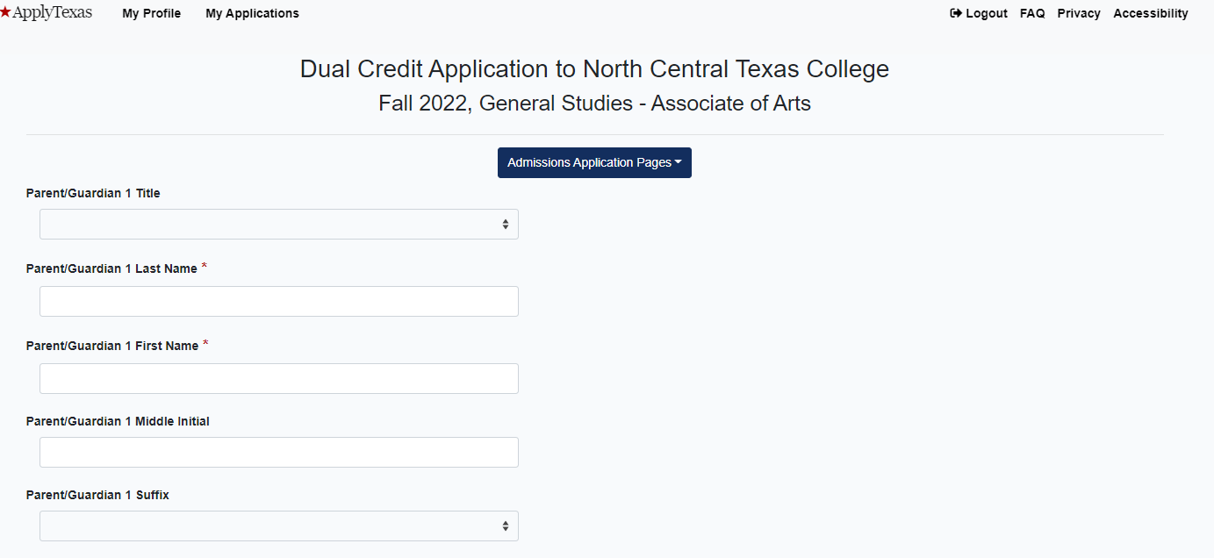
Enter Parent/Guardian Information

Slide 32
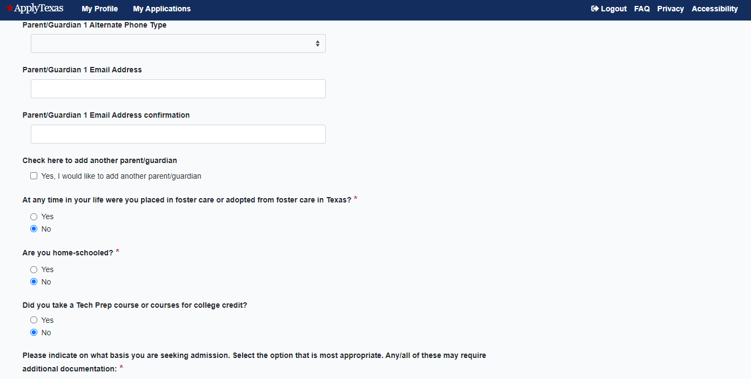
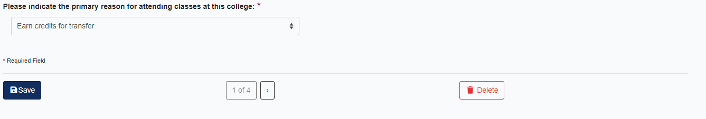
ANSWER EACH QUESTION
NO
NO
DUAL CREDIT

Slide 33
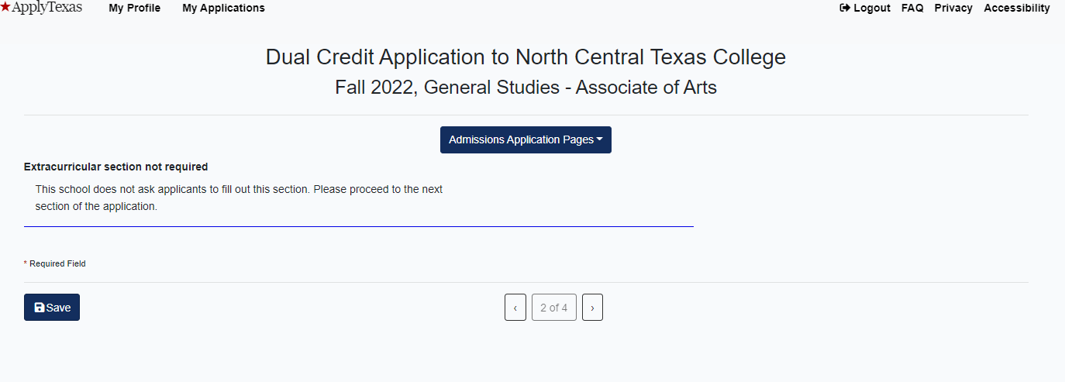
SKIP
Proceed

Slide 34
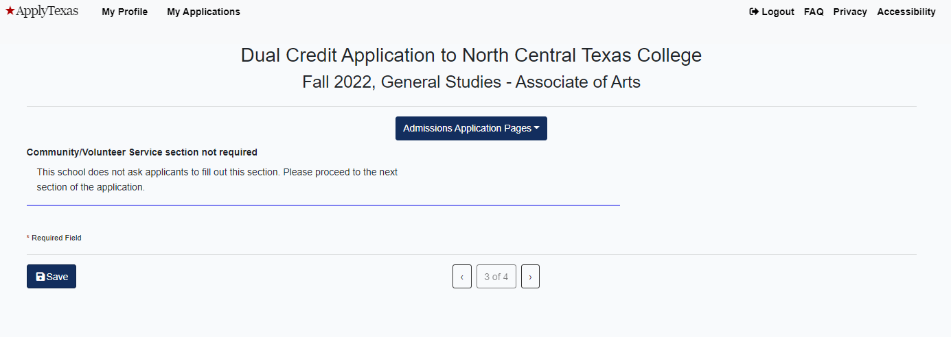
SKIP
Proceed

Slide 35
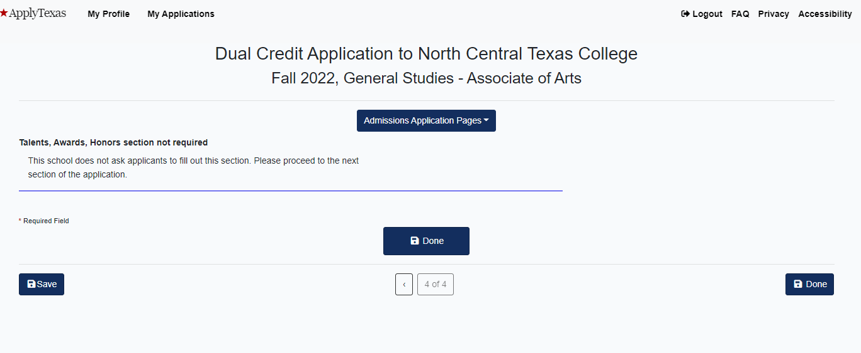
SKIP
Proceed

Slide 36
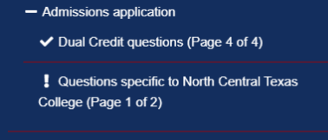
Scroll down until you see this:
Click Questions specific to NCTC
Click to expand menu

Slide 37
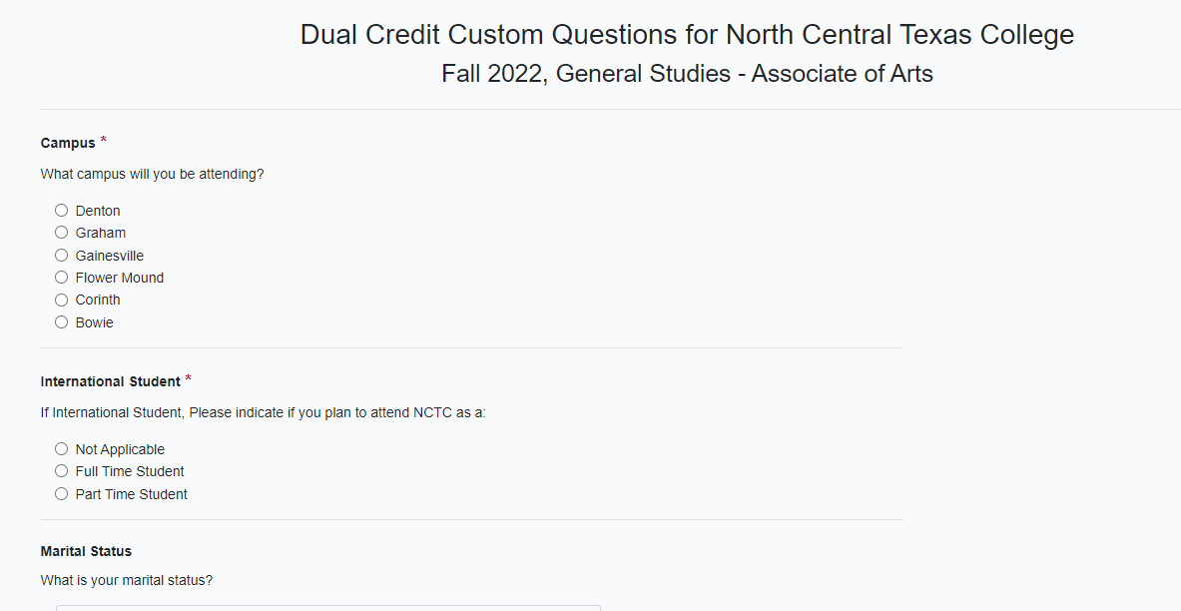
Pick campus closest to where you live
Lewisville ISD: pick Flowermound
All other Denton County public schools: pick Corinth
Not Applicable
Single

Slide 38
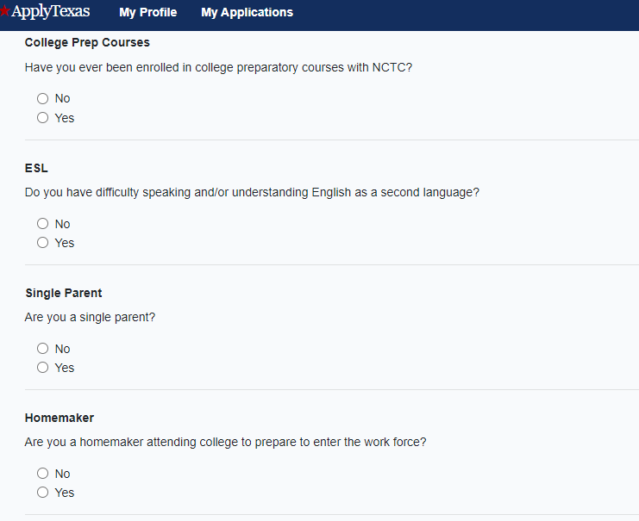
NO

Slide 39
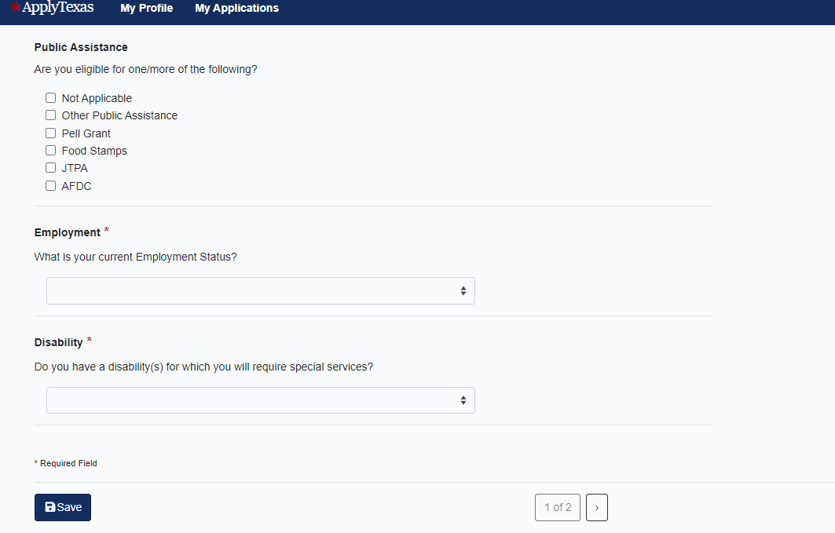
Not Seeking Employment
Proceed

Slide 40
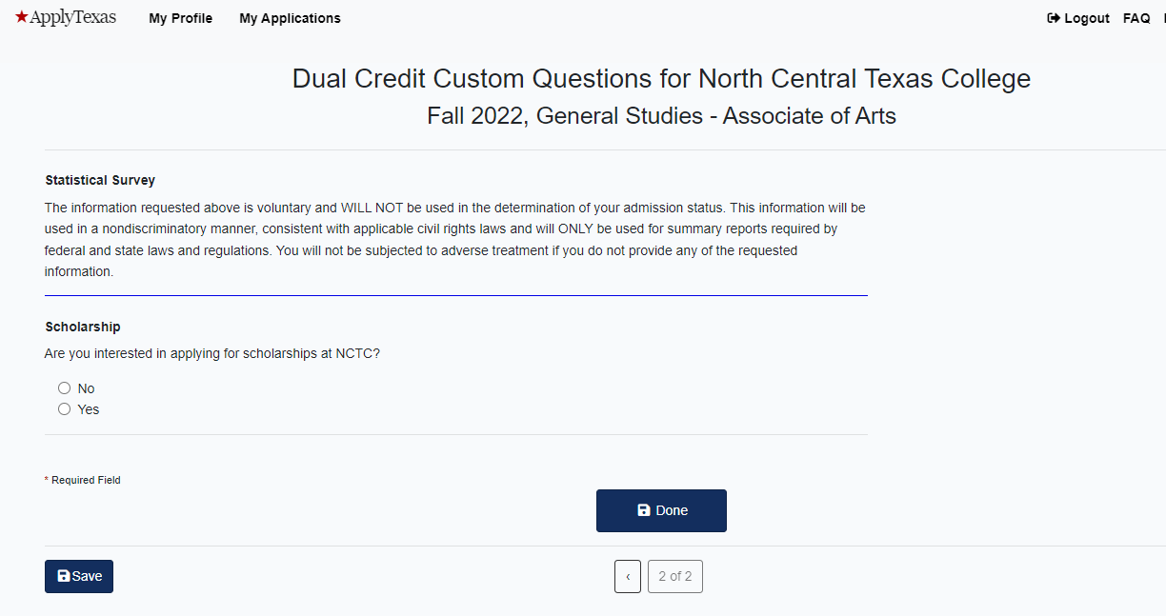
YES
Proceed

Slide 41
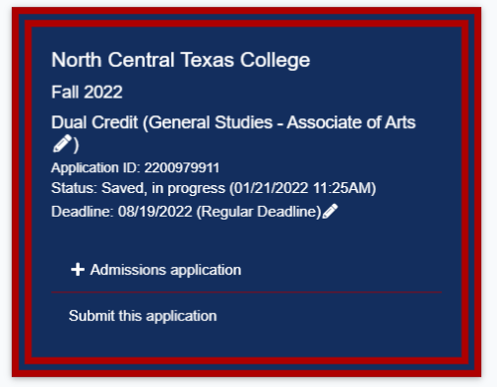
Scroll down until you see this:
Click Submit this application

Slide 42

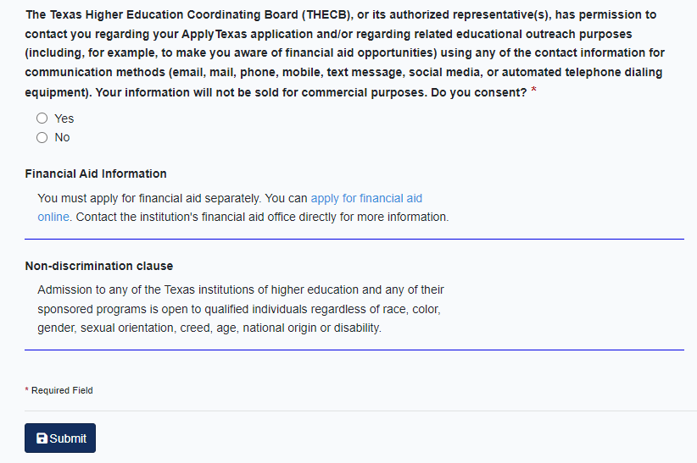
Read statements, check certification boxes
Click submit and you’re done!

